Slide 1

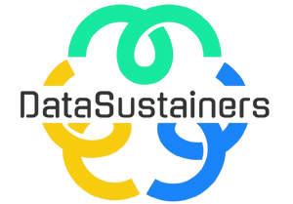



Accenture Innovation Challenge 2024
Team Name: DataSustainers
Keshari Sakharkar (Leader)
College:G.H Raisoni College of Engineering and Management,Pune
Stream:CSE(Cyber Security)
Year of Graduation:2026
Aniket Sabale
College:G.H Raisoni College of Engineering and Management,Pune
Stream:CSE(Cyber Security)
Year of Graduation:2026
Notes:
1

Slide 2

Problem Statement
Enhancing Sustainability Through Data-Driven AI/ML Solutions
In today's world, sustainability is the universal challenge for an individual and a business organization. Effective resource management and sustainable practices are often hindered by the lack of understanding of consumption patterns, inefficient use of resources, and misalignment with sustainability metrics such as carbon footprint and ESG (Environmental, Social, Governance) goals. Current approaches to behavior modification for energy and resource conservation are generic and fail to provide personalized, actionable insights based on real-world data.
Obj 1.
To Develop an AI-powered platform that analyzes user data and behavior patterns
Obj 3.
To track progress, provide real-time feedback, and align with key sustainability goals such as ESG compliance.
To analyze data from reliable sources, generate sustainability metrics, and offer tailored suggestions by using AI and Machine Learning
Obj 2.
To provide personalized recommendations to improve sustainability
Obj 4.

Slide 3
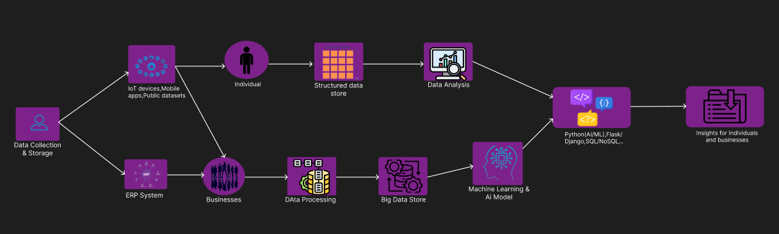
Proposed Solution
1. Data Collection & Storage
Collect data for individuals and businesses.
Store structured data in SQL and unstructured data in NoSQL databases.
2. AI/ML for Behavior Analysis
Use clustering for grouping users by behavior and regression models/Classification models for predicting business resource trends and personalized recommendations for improving sustainability
3. Sustainability Metrics & ESG Alignment
Track carbon footprint, water use, and waste, aligned with ESG goals.
4. Recommendation Engine
Offer tailored suggestions, improving through user feedback.
5. User Interface & Reporting
Build a user-friendly dashboard to track progress and generate automated sustainability reports. Align reports with ESG requirements.
6. Tech Stack
Python (AI/ML), SQL/NoSQL databases, React.js (frontend), Flask/Django (backend), cloud infrastructure (AWS/Azure).

Slide 4
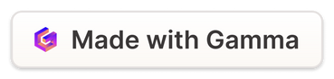
How does your innovation accelerate change with the power of Technology?
1
Data-Driven Insights Real-time Data Collection
2
Personalized Recommendations Tailored Solutions
Real-time Data Collection: By integrating data from IoT devices, mobile apps, and public sources, the platform continuously monitors resource consumption.
Accurate Predictions: AI/ML models analyze vast amounts of data to identify inefficiencies and predict future trends, enabling proactive action.
The system provides actionable, personalized suggestions for reducing resource use, customized to individual and business needs.
Continuous Improvement: Through reinforcement learning, the platform gets smarter over time, adjusting recommendations based on real-world feedback.
3
Automation and Scalability Automated Reports
4
Impact at Scale Empowerment through Technology
The platform automates sustainability tracking and reporting, saving time and ensuring alignment with ESG goals.
Scalable Technology: Cloud infrastructure (AWS/Azure) ensures scalability, allowing businesses of all sizes to implement sustainable practices easily.
The use of intuitive dashboards makes it easier for users to track their progress and stay engaged.
Broad Reach: By leveraging data and automation, the platform can impact a wide range of industries, accelerating the adoption of sustainable practices across sectors.
Notes:
11

Slide 5
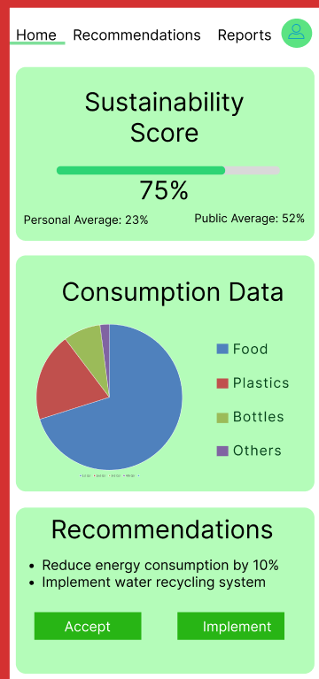
Prototype Overview
Home Screen:
Sustainability Score: Displays overall score for sustainability practices.
Current Status: Shows real-time consumption data (energy, water).
Progress Tracker: Visual indicator of improvements over time.
Data Visualization:
Graphs/Charts: Interactive graphs for energy and waste tracking (daily, monthly).
Comparison Benchmarks: Users compare their data to industry averages.
Recommendations Section:
Tailored Suggestions: Personalized tips for improving sustainability.
Action Buttons: Options to accept or implement recommendations.
Impact Analysis: Shows potential improvements to sustainability score.
Detailed Reports:
ESG Alignment: Reports for businesses on alignment with ESG goals.
Progress Breakdown: Insights by category (energy, waste, transportation).
Download Reports: Option to download detailed PDF reports.
Leaderboards (Optional):
Community Comparison: Ranks users against others based on sustainability scores.
Incentives: Rewards or badges for achieving milestones.
User Profile Section:
Preferences: Customize recommendation types.
Historical Actions: Log of past actions taken based on suggestions.

Slide 6
How is your solution different/unique from other solutions in market?
1
AI-Powered Personalization Tailored Recommendations:
Unlike many platforms that offer generic advice, my solution uses advanced AI/ML models (clustering, regression) to analyze unique user data and deliver highly personalized sustainability recommendations for both individuals and businesses.
Continuous Learning: Reinforcement learning ensures that the recommendations improve over time, adapting to user behavior and feedback, making the platform more effective the longer it’s used.
2
Comprehensive Data Integration Multiple Data Sources
The solution integrates data from IoT devices, mobile apps, ERP systems, and public datasets, offering a holistic view of resource consumption. This diverse data stream provides more accurate and insightful analysis compared to platforms relying on fewer data inputs.
Structured and Unstructured Data: By utilizing both SQL and NoSQL databases, it can handle both structured and unstructured data, enabling deeper analysis and greater flexibility.
3
Alignment with ESG Goals ESG Focus
The platform aligns sustainability metrics with ESG (Environmental, Social, Governance) compliance, providing businesses with automated, real-time reports that ensure adherence to regulatory and corporate sustainability standards.
Actionable Metrics: It doesn’t just track sustainability performance; it translates it into clear, actionable suggestions for improvement, making it easier for users to achieve their sustainability goals.
User-Centric Design Intuitive Dashboards
4
The user interface is designed to be simple and easy to navigate, with real-time progress tracking and automated reporting. This makes it accessible even to non-experts and helps drive user engagement.
Both Individual and Business Focus: Unlike some solutions that focus exclusively on either individuals or businesses, my platform serves both, ensuring a broader impact.

Slide 7
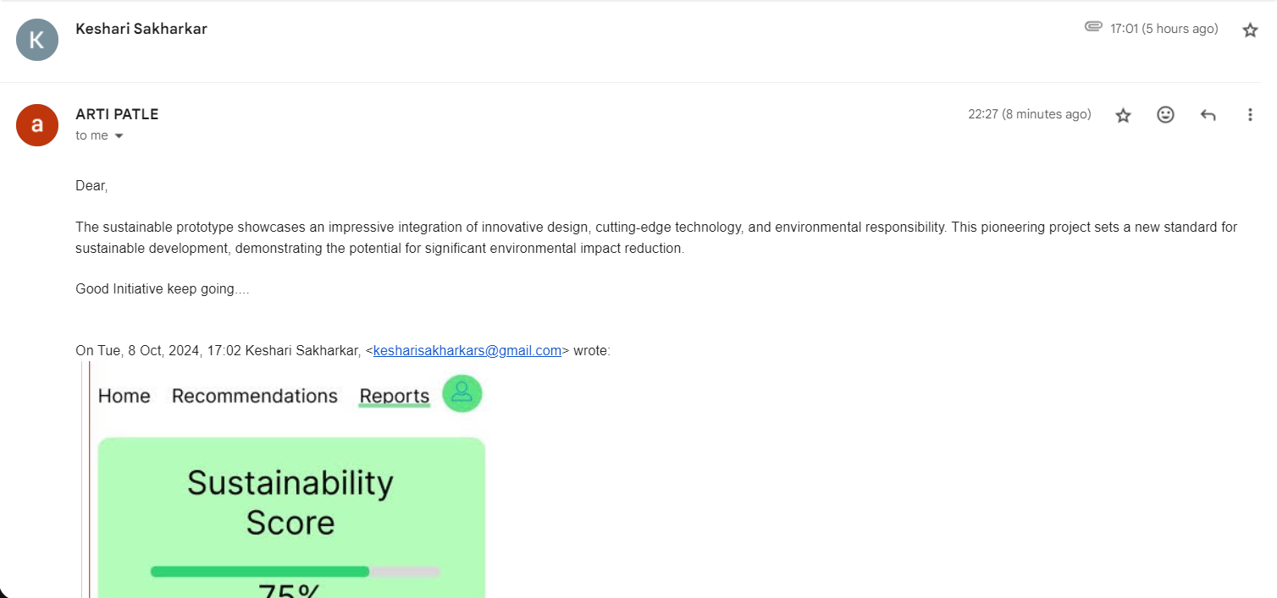
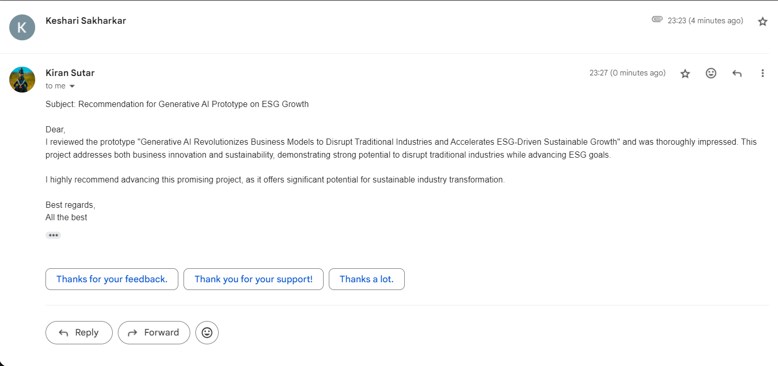
Testimonial

Slide 8
Advantages
Personalized Recommendations
AI/ML models provide customized, actionable suggestions for individuals and businesses, improving engagement and effectiveness in reducing energy, water, and waste.
Data-Driven Insights
Continuous monitoring and analysis of real-time data ensure that decisions are based on actual consumption patterns, leading to more precise optimizations.
Sustainability Metrics
The system aligns with key sustainability goals (carbon footprint, waste reduction) and generates automated ESG-compliant reports, simplifying regulatory adherence for businesses.
Scalable Solution
The approach can handle large datasets from diverse sources (IoT devices, apps, reports) using cloud infrastructure and scalable databases, making it adaptable for both individuals and enterprises.
User-Friendly Interface
The intuitive dashboard enables easy tracking of sustainability progress, comparison with benchmarks, and real-time updates, improving user awareness and motivation.

Slide 9
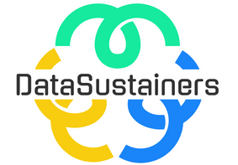

Conclusion: A Sustainable Future Powered by AI/ML
AI/ML has the potential to drive a transformative shift towards a more sustainable future. By addressing challenges and embracing research opportunities, we can leverage AI/ML to create a healthier, more equitable, and sustainable world for generations to come.
Notes:
13

